Slide 1
Challenges to evaluating and staging gastric cancer
Fatima Carneiro
Institution*Faculdade de Medicina da Universidade do Porto,
*Hospital Universitário São João, *Ipatimup/i3S;

Slide 2
Declaração de Conflito de Interesse
Dra. Fátima Carneiro afirma não ter conflito
de interesse a declarar
Exigência da RDC Nº 96/08 da ANVISA

Slide 3

LEARNING OBJECTIVES
Learning objectives
To recognize the major histological types of gastric cancer
To recognize the rare variants of gastric cancer
To understand the clinical impact of a precise classification of gastric cancer

Slide 4
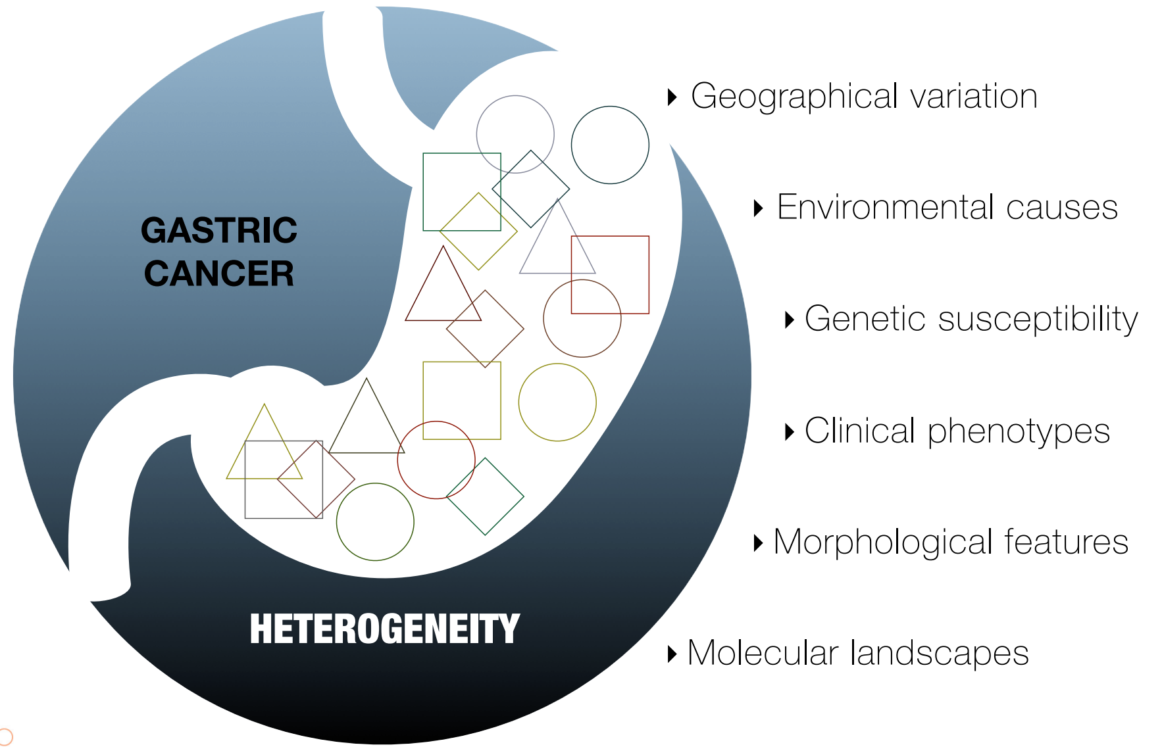
Gastric cancer is very heterogeneous
Irene Gullo

Slide 5
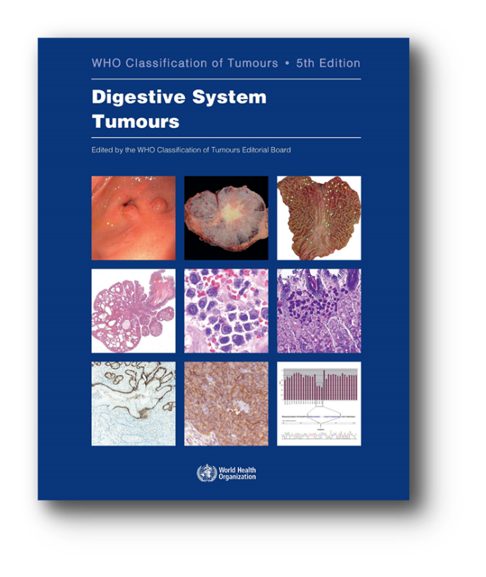

WHO Classification of Tumours of the Digestive System, 5th edition, 2019

Slide 6
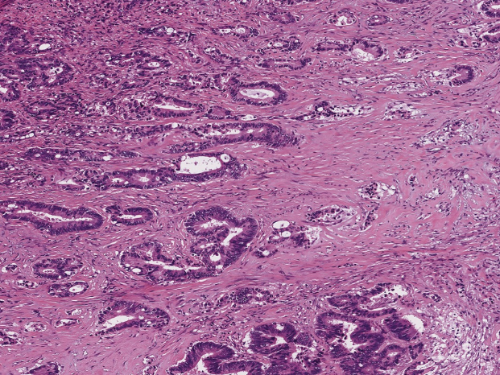
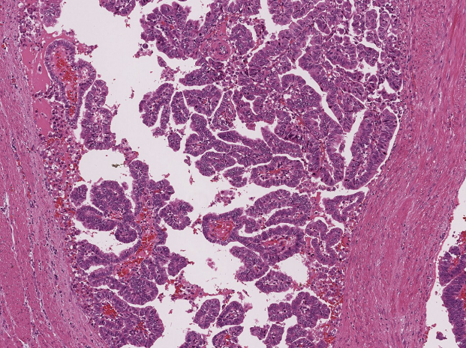
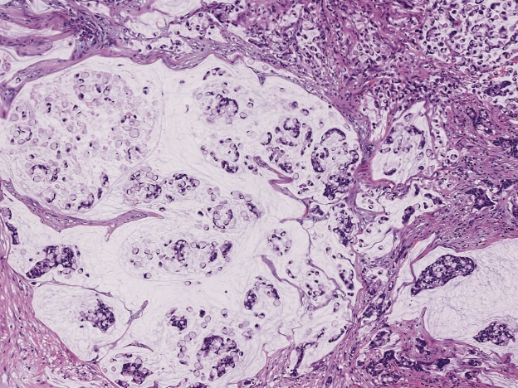
WHO Classification of Tumours of the Digestive System, 5th edition, 2019
Tubular adenocarcinoma
Papillary carcinoma
Mucinous carcinoma
Tubules invading the muscle layer
Fibro vascular cores lined by columnar cells
Nests of neoplastic cells
floating in extracellular mucin pools

Slide 7
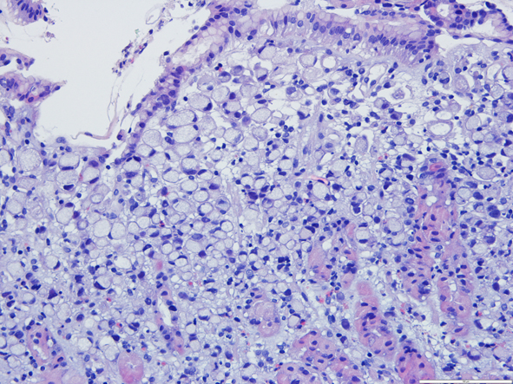
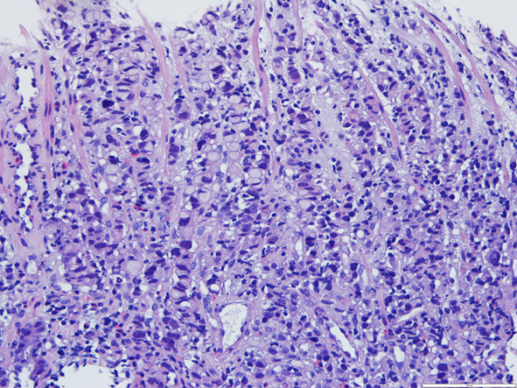
WHO Classification of Tumours of the Digestive System, 5th edition, 2019
Poorly cohesive carcinoma (PCC)
Predominantly signet-ring cells, larger at the superficial part of the mucosa
Poorly cohesive cells of non–signet-ring cell type; invasion with desmoplasia

Slide 8
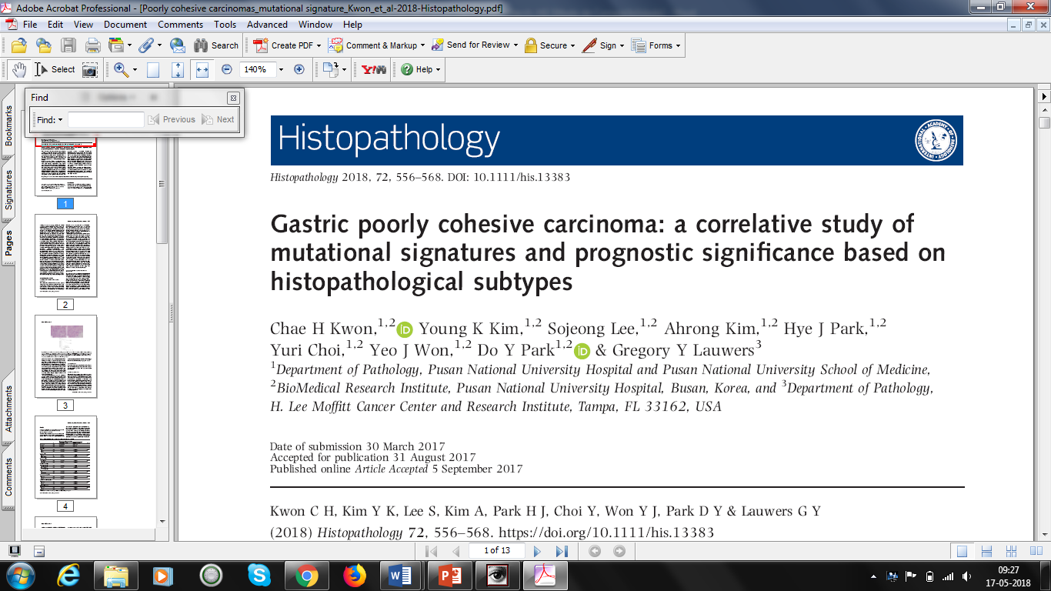
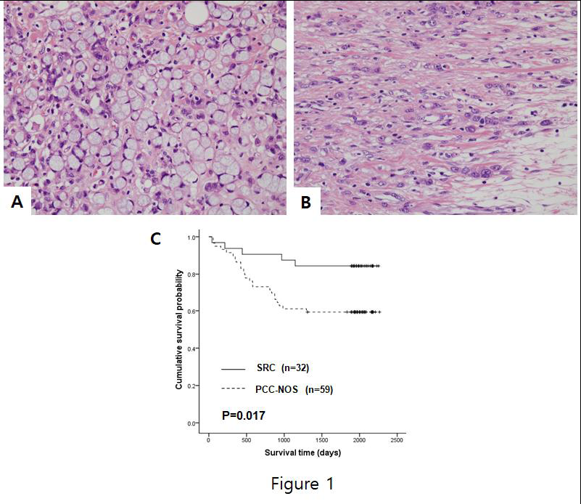
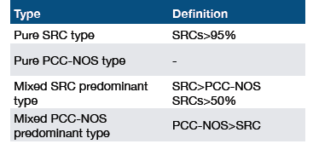
Slide Title

Slide 9
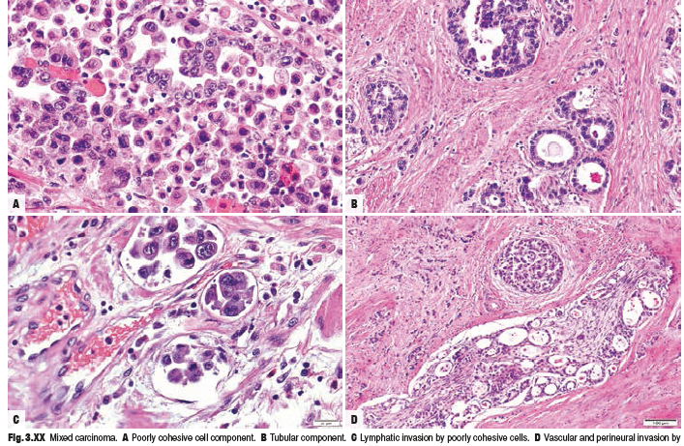
WHO Classification of Tumours of the Digestive System, 5th edition, 2019
Mixed (adeno)carcinoma
- Larger tumour size
- Deeper invasion
- Cumulative effect of the adverse behaviours
of each component
- Dual metastatic pattern
- Worse prognosis
Carneiro F et al Pathol Res Pract 1995; Shimizu H et al J Surg Oncol 2012; Min BH et al Gastric Cancer 2015; Gullo I et al Pathobiology 2018

Slide 10
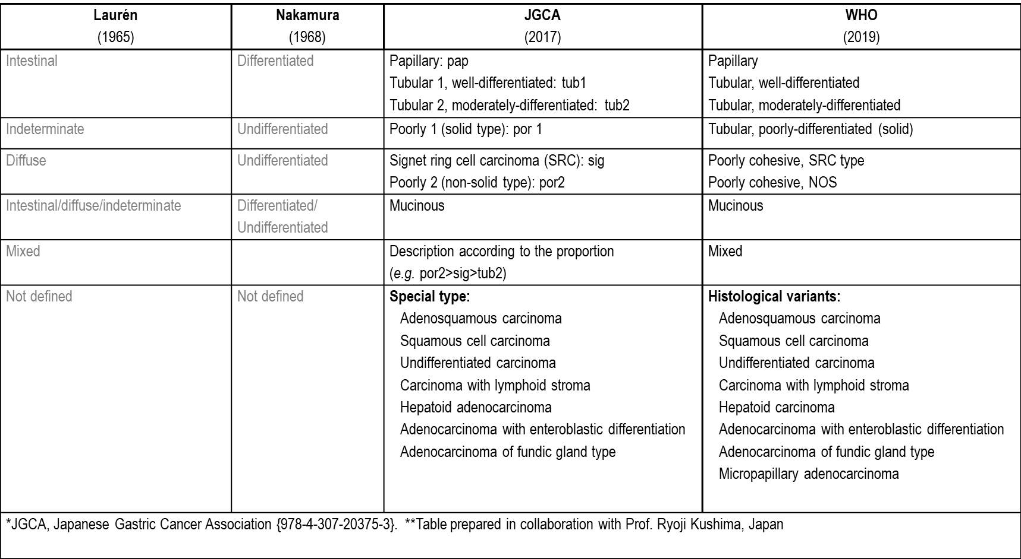
WHO Classification of Tumours of the Digestive System, 5th edition, 2019

Slide 11
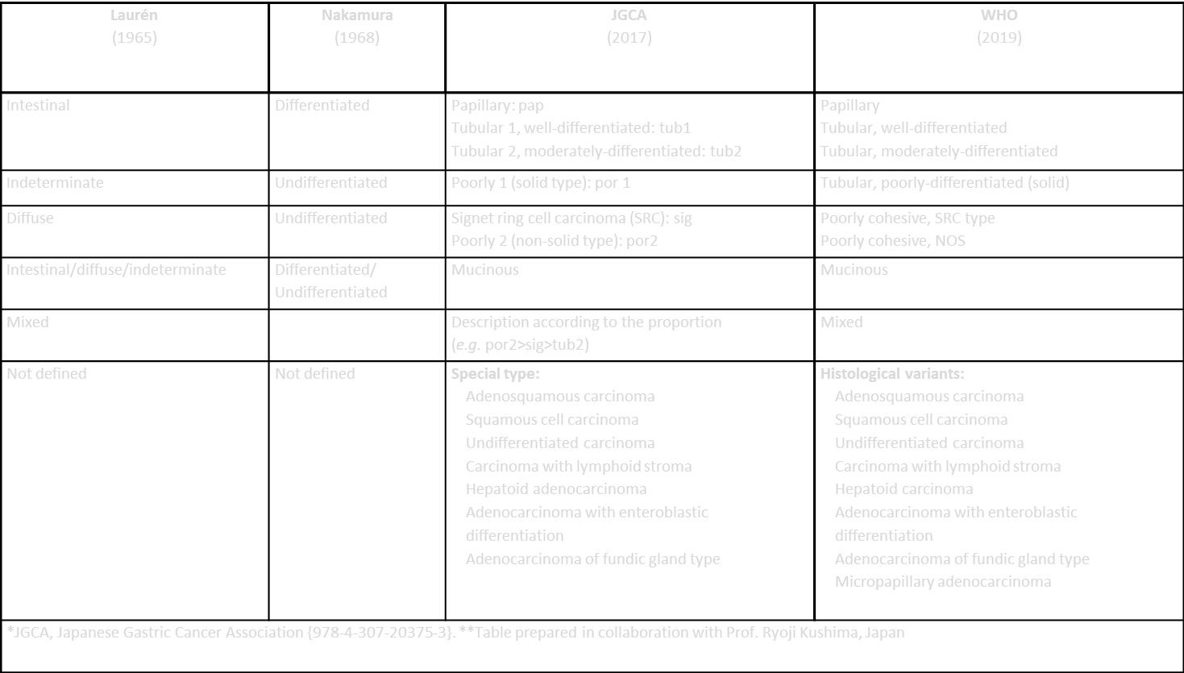
wHO Classification of Tumours of the Digestive System, 5th edition, 2019
Histological variants:
Adenosquamous carcinoma (separate chapter)
Squamous cell carcinoma (separate chapter)
Undifferentiated carcinoma (separate chapter)
Hepatoid carcinoma
Adenocarcinoma with enteroblastic differentiation
Micropapillary adenocarcinoma
Carcinoma with lymphoid stroma
Adenocarcinoma of fundic gland type
...

Slide 12
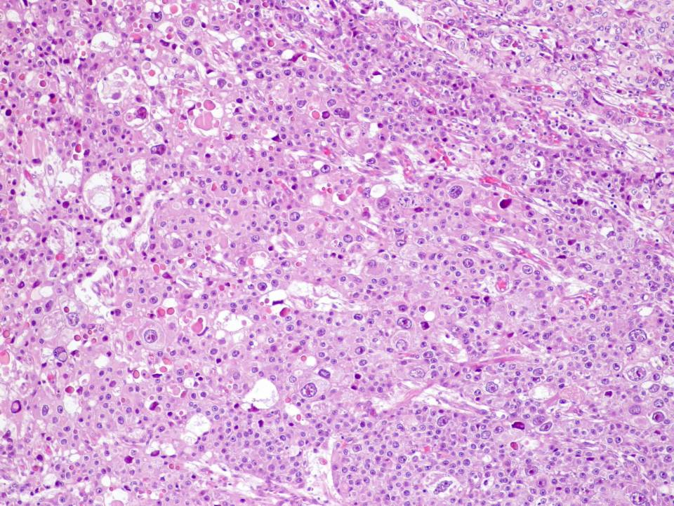
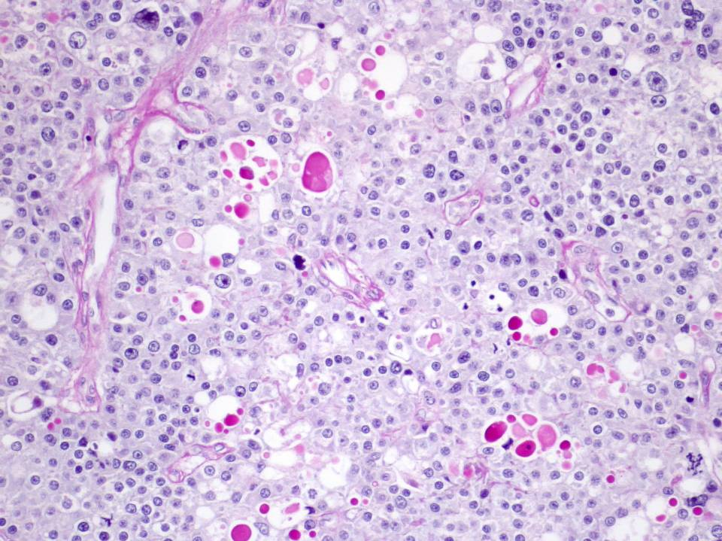
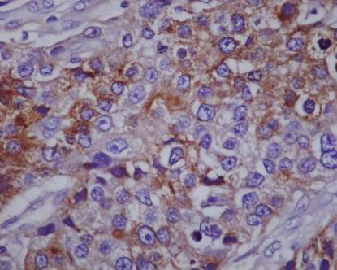
wHO Classification of Tumours of the Digestive System, 5th edition, 2019
Hepatoid carcinoma
Poor prognosis
PAS
AFP

Slide 13
Differential diagnosis in liver biopsies
Primary hepatocellular carcinoma (HCC)
versus
Liver metastasis from gastric hepatoid carcinoma
HepPar-1 is expressed in most HCCs (extensive staining ) and is only focal observed in gastric hepatoid carcinomas
PLUNC (palate, lung and nasal epithelium carcinoma-associated protein) is a marker for gastric hepatoid carcinoma
.
SALL4, CK19 and CK20 is differentially expressed in gastric hepatoid carcinomas but not HCCs
Claudin-6 appears as a reliable marker of AFP-producing gastric adenocarcinomas (90%)

Slide 14
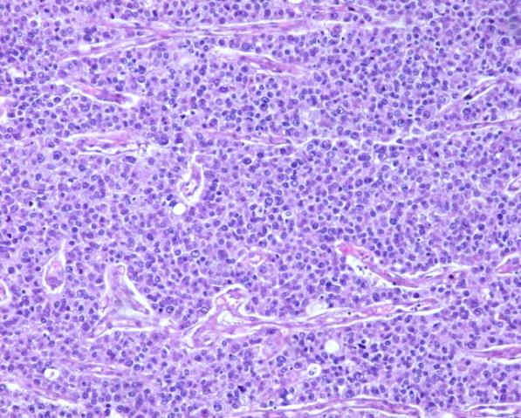
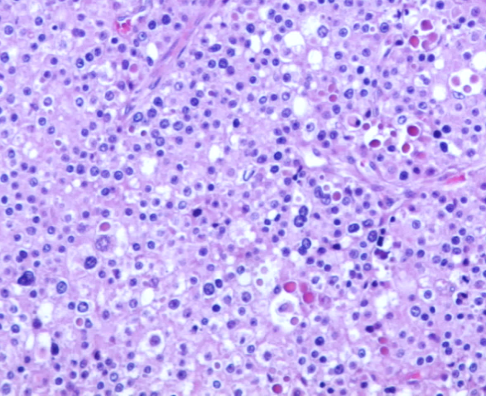
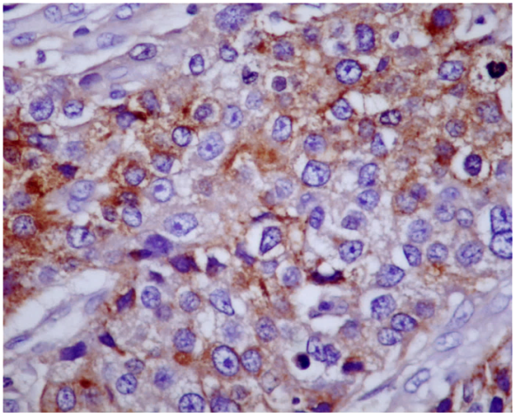
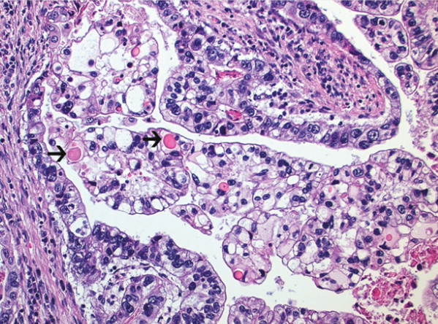
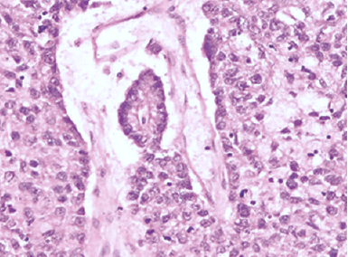
Hepatoid Carcinoma
Poor prognosis
AFP
Other AFP-producing gastric carcinomas
Gastric adc with enteroblastic differentiation
Tubulo-papillary adc with clear cytoplasm
Yolk-sac tumor-like carcinoma

Slide 15
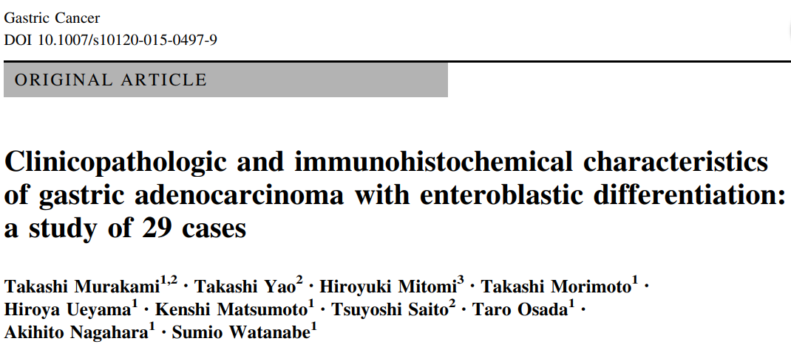
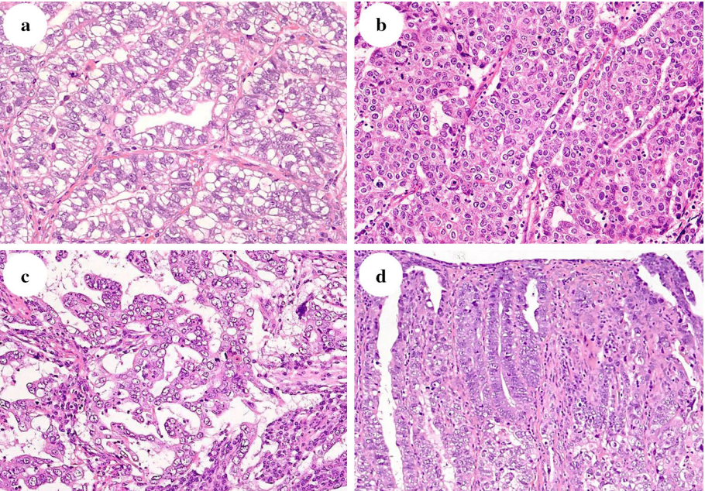
A combination of different histological types may be seen in many cases
GAED
Hepatoid adenocarcinoma
Hepatoid adenocarcinoma
Yolk sac tumor pattern
Conventional adenocarcinoma
Yolk sac tumor pattern
Conventional adenocarcinoma

Slide 16
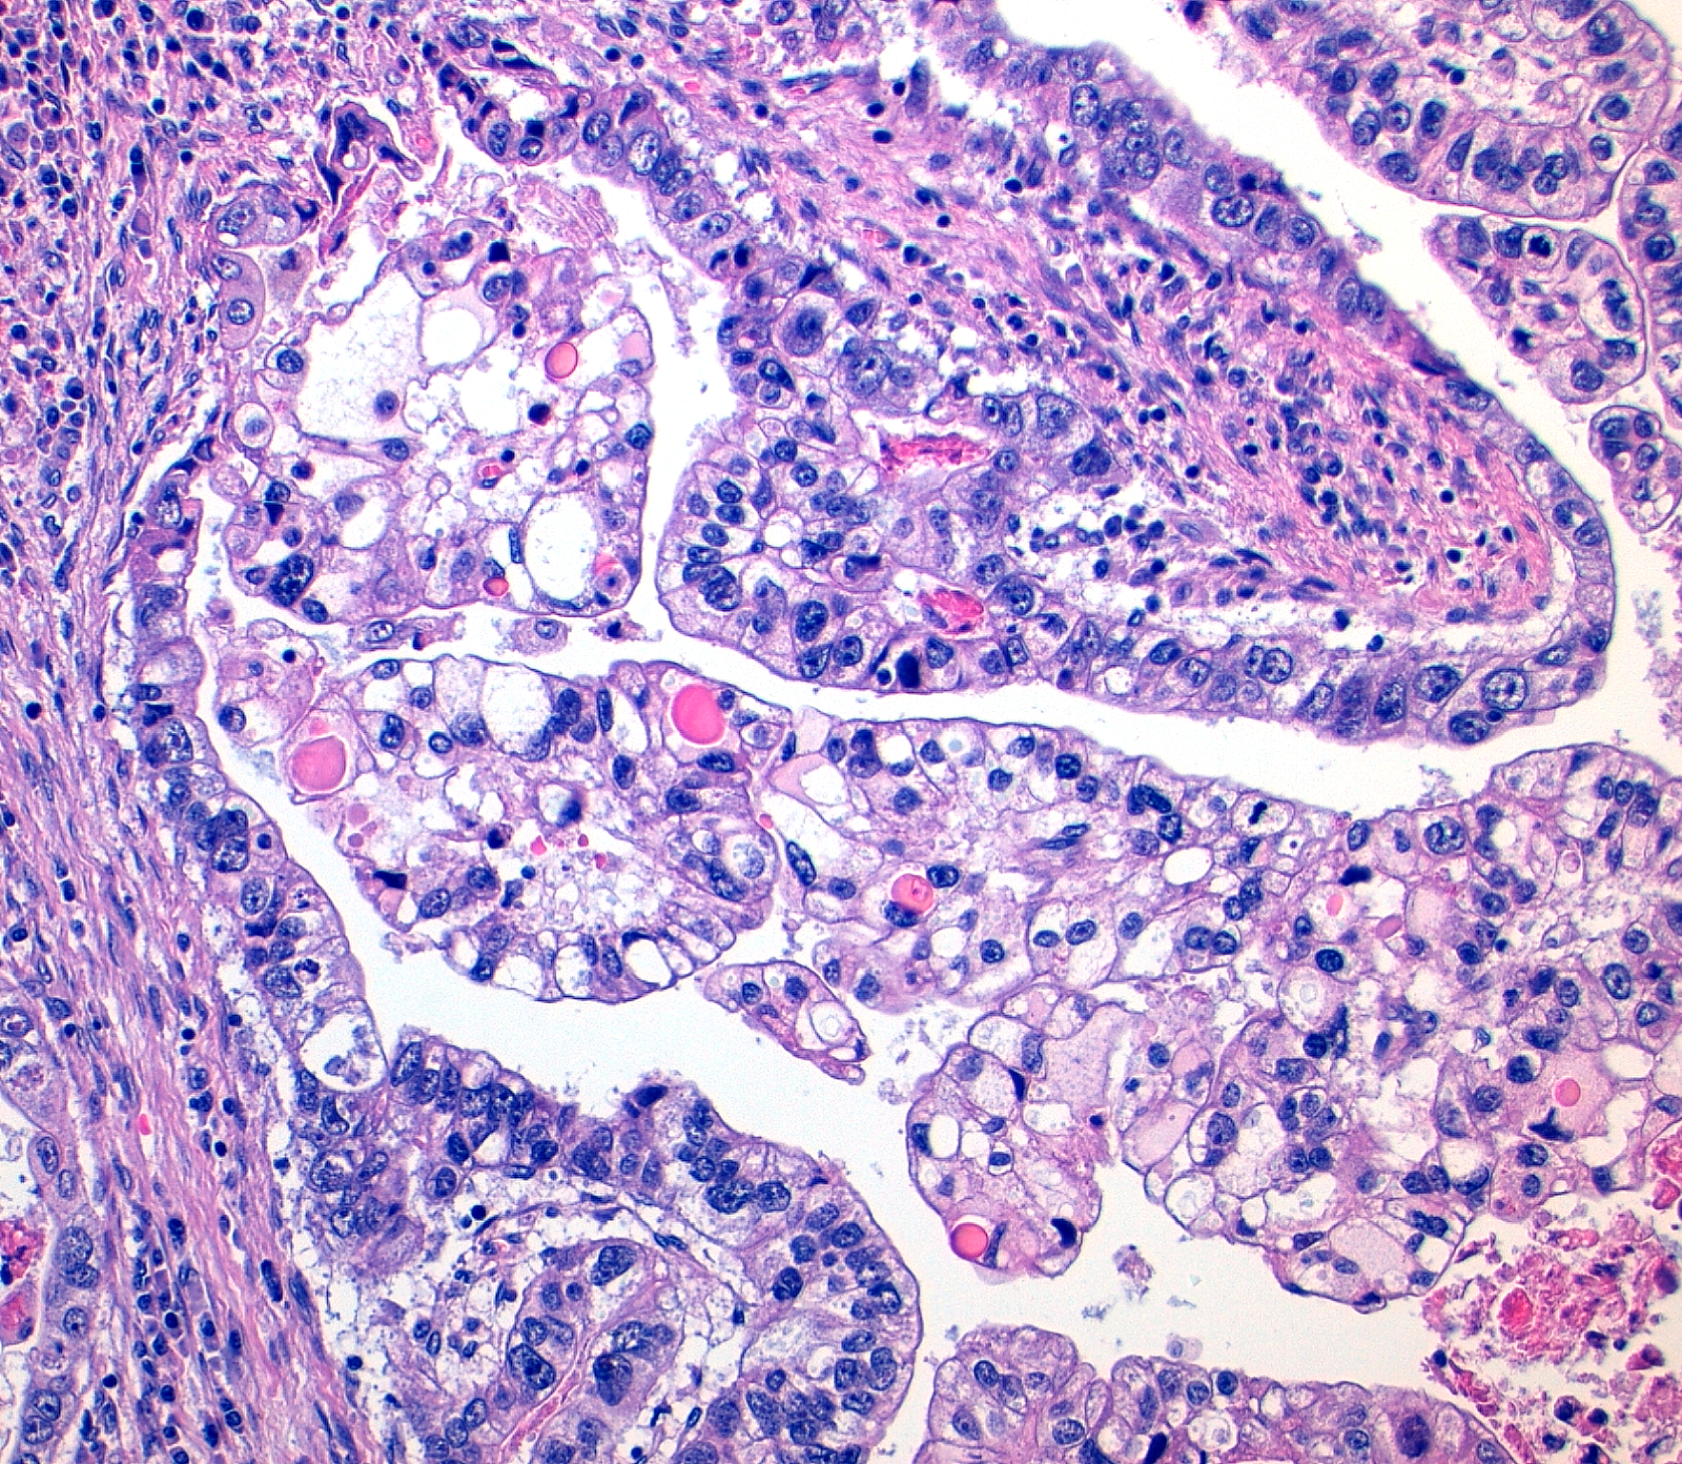
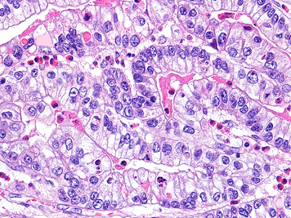
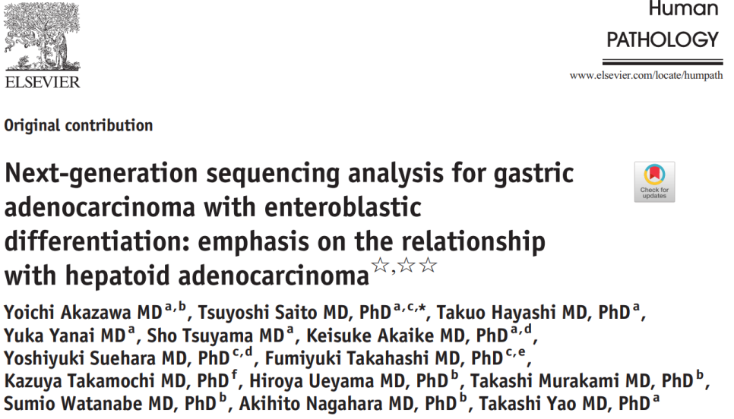
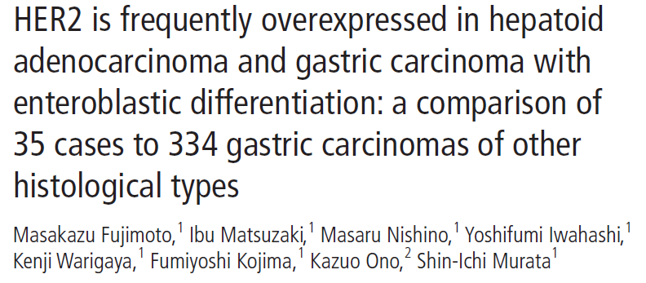
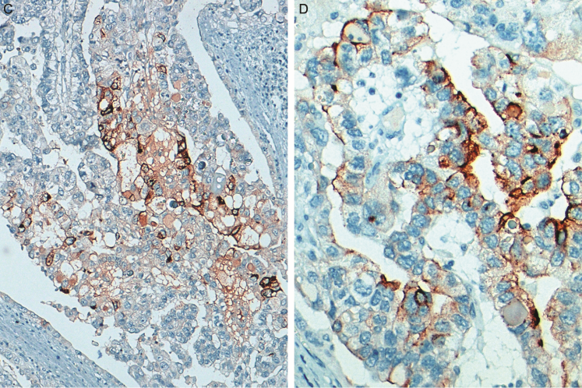
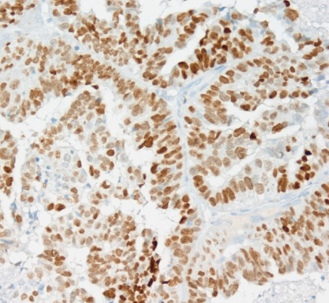
Slide Title
What about molecular features?
Adenocarcinoma with enteroblastic differentiation
GAED frequently harbors TP53 mutations and ERBB2 amplification.
AFP
Glypican-3
SALL4

Slide 17
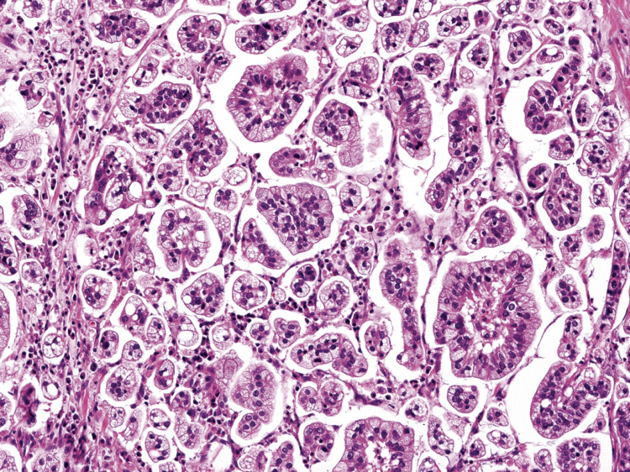
WHO Classification of Tumours of the Digestive System, 5th edition, 2019
Invasive micropapillary adenocarcinoma
Poor prognosis
The tumour clusters display the characteristic inside-out growth pattern, with the luminal pole of the cells present on the outer surface of the cluster

Slide 18
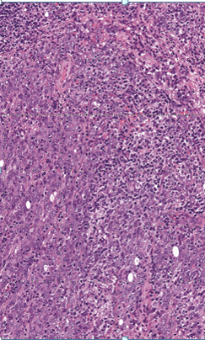
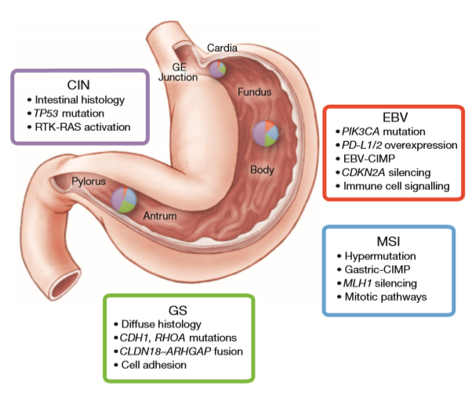
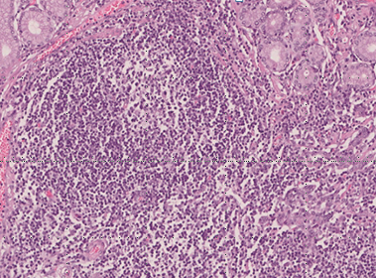
Gastric carcinoma with lymphoid stroma
Histological features
Molecular features
70%-80%
GCLS
10%-20%

Slide 19
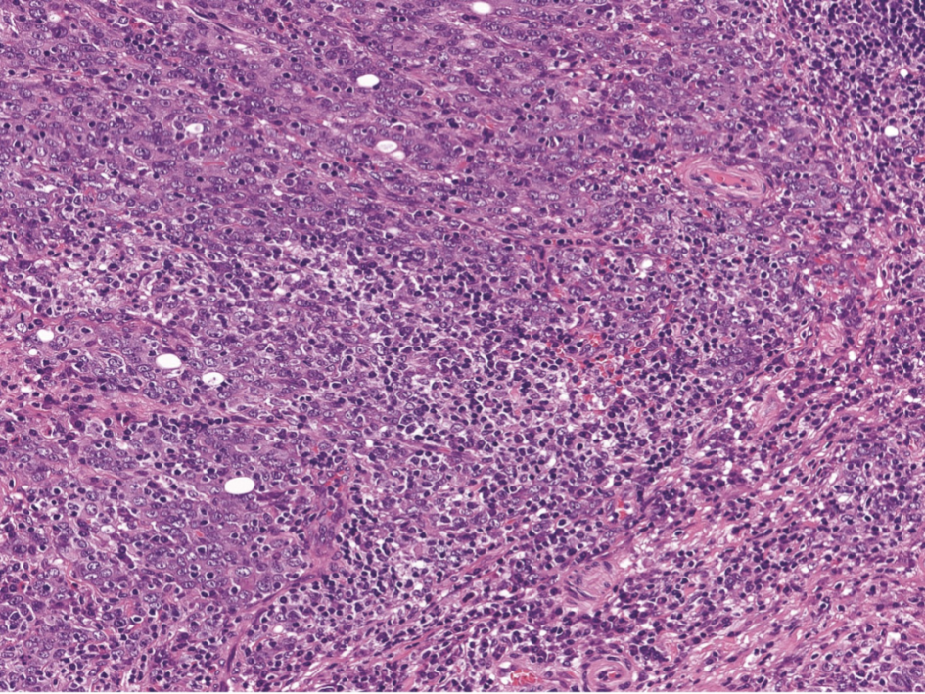
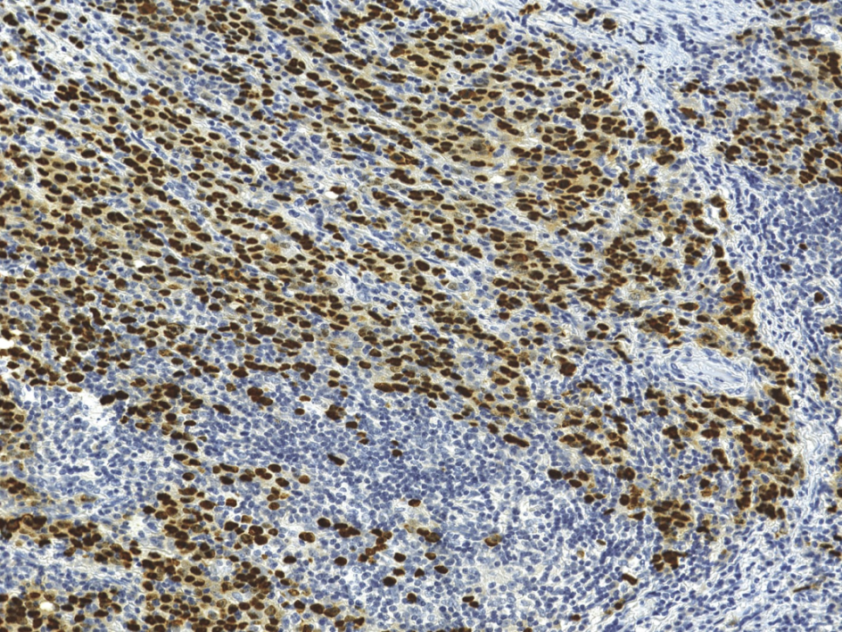
WHO Classification of Tumours of the Digestive System, 5th edition, 2019
Gastric carcinoma with lymphoid stroma (EBV-positive gastric cancer)
Good prognosis
Cancer cells form small nests or fused glands, accompanied by abundant lymphocyte infiltration. Nuclei of carcinoma cells are positive by in situ hybridization targeting EBV-encoded small RNA (EBER). Nuclei of infiltrating lymphocytes are negative.

Slide 20
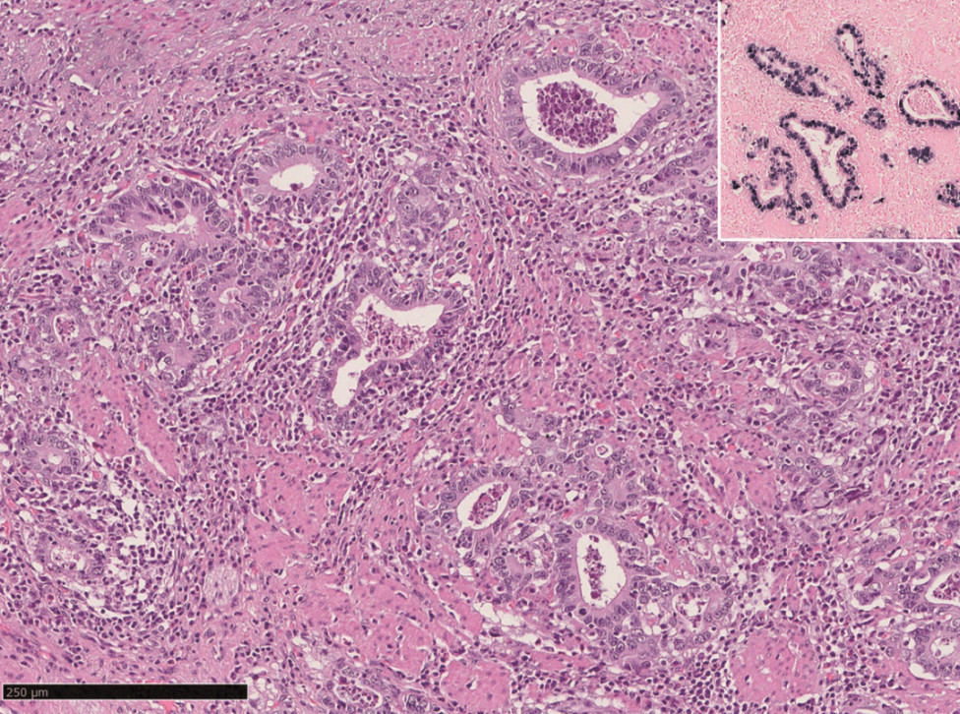
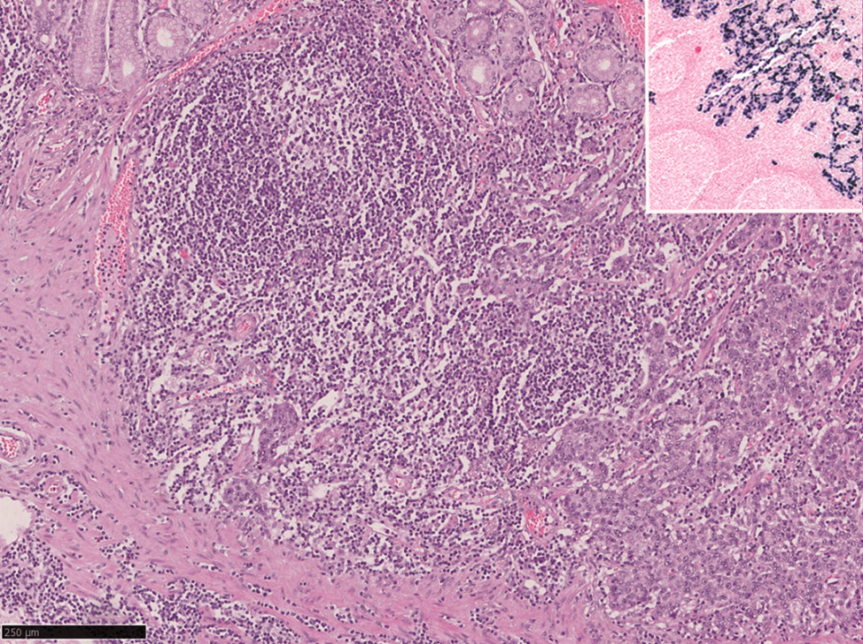
WHO Classification of Tumours of the Digestive System, 5th edition, 2019
EBV-positive gastric cancer (other phenotypes)
Tubular carcinoma with moderate desmoplasia
Carcinoma with Crohn’s like lymphoid reaction

Slide 21
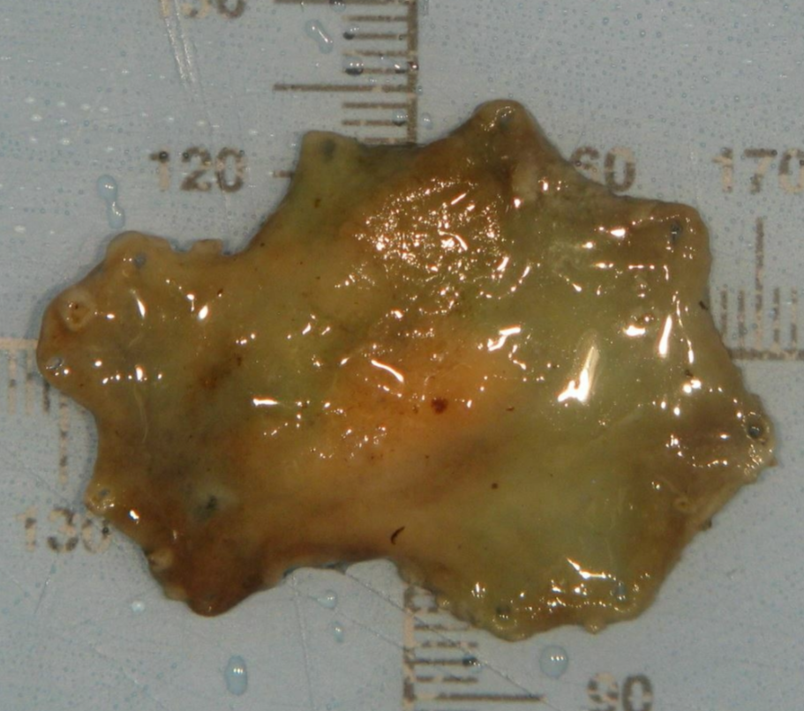
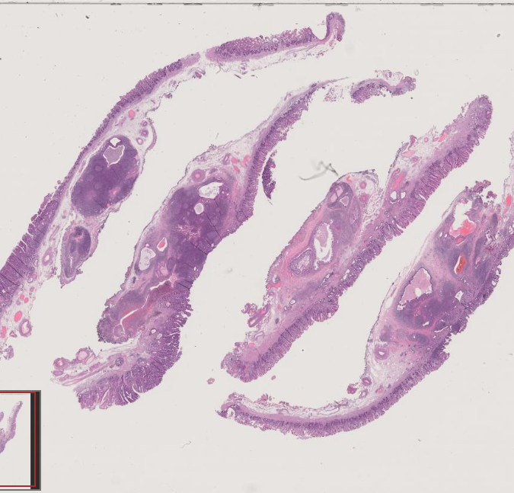
ESD Specimen

Slide 22
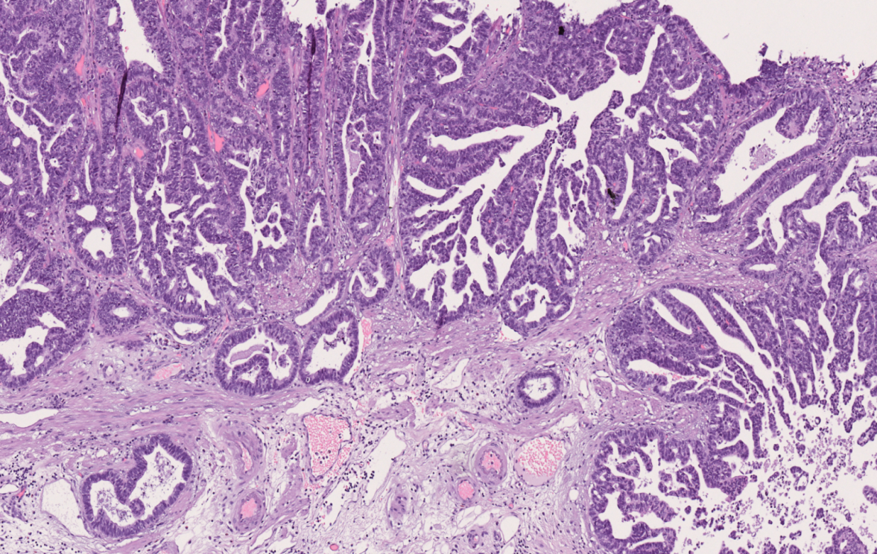
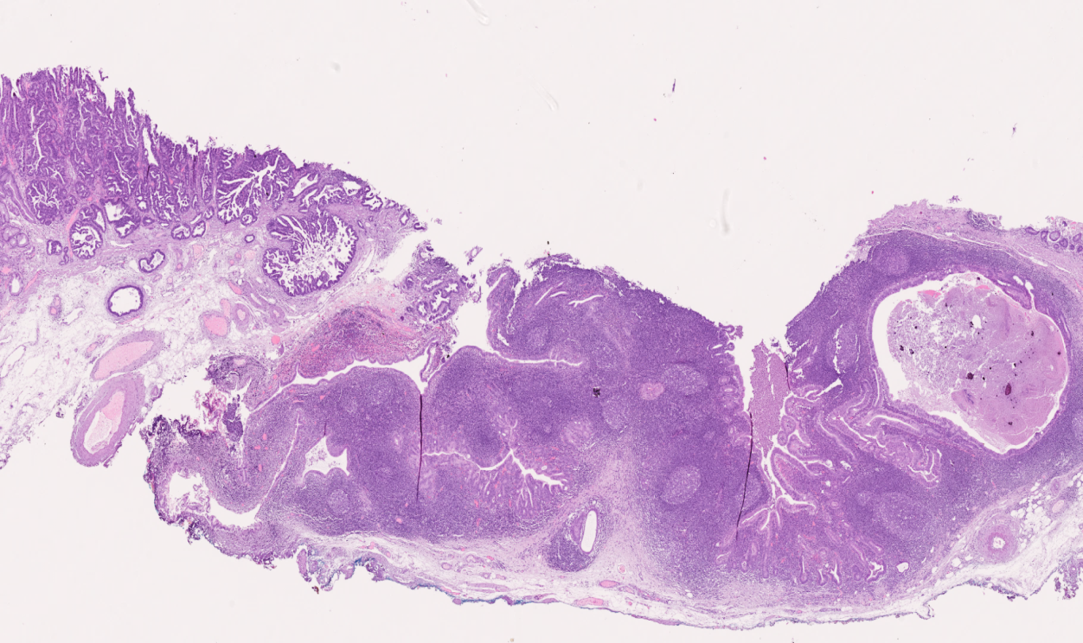
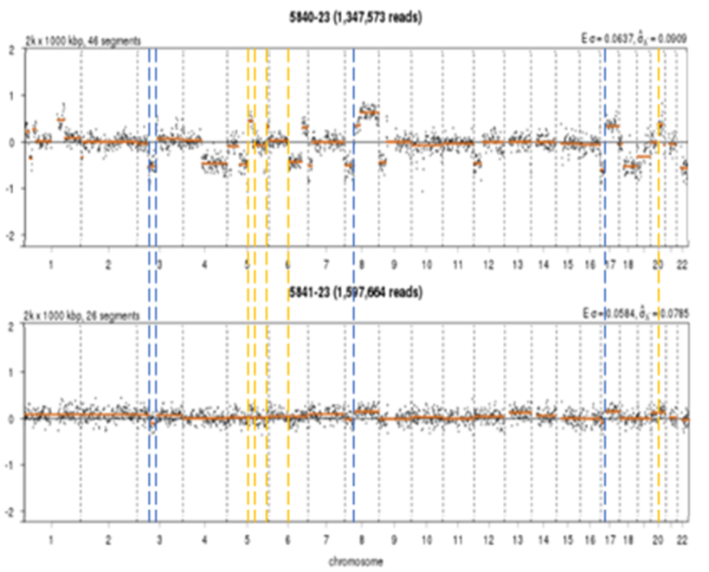

GC with lymphoid stroma (GCLS) and
tubulo-papillary (TP) adenocarcinoma
GC with a component of tubulo-papillary (TP) adenocarcinoma (low-grade)
Shallow Whole Genome Sequencing (sWGS)
EBV read counts
EBV
Bi-phenotypic gastric carcinoma
GCLS (EBV+) and
Tubulo-Papillary (EBV-) components

Slide 23

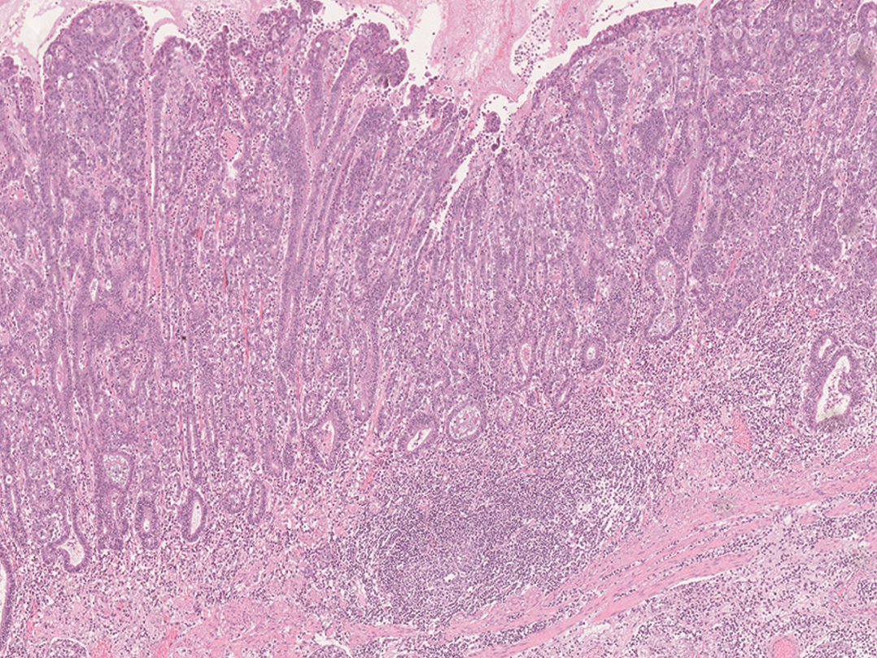
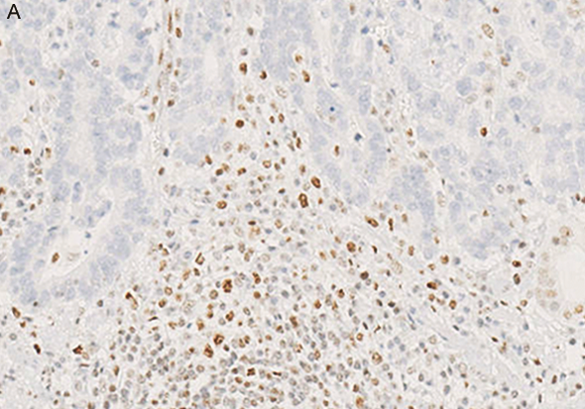
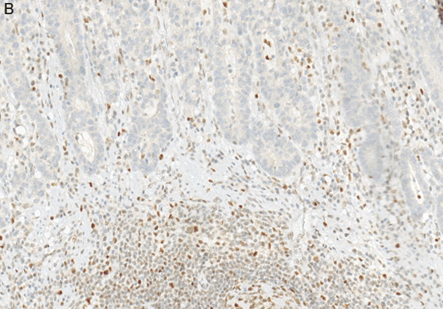
Gastric carcinoma with lymphoid stroma
(MSI-positive gastric cancer )
Gastric carcinoma with lymphoid stroma
Carcinoma with Crohn’s like lymphoid reaction
MLH1
PMS2

Slide 24
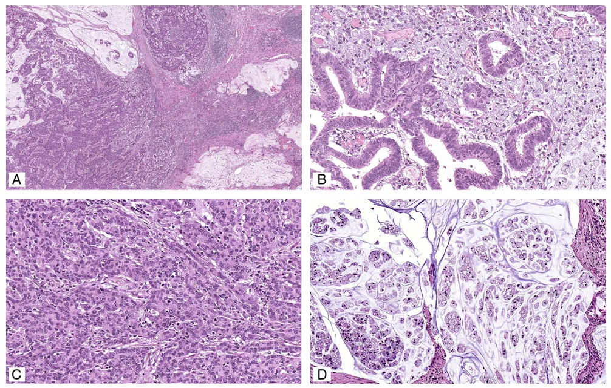
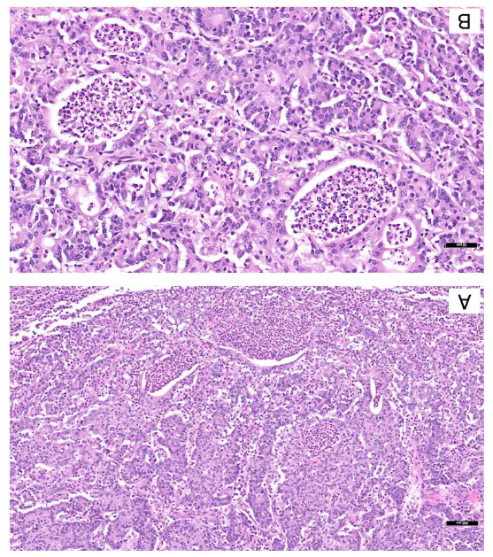
Microssatellite instability prediction in gastric cancer
In surgical specimens, the morphological features predictive of
MSI included the presence of solid and/or mucinous components
(P=0.034 and P<0.001) and the presence of neutrophil-rich stroma, distant from tumor ulceration/ perforation (P< 0.001).
Am J Surg Pathol, 2023
Silva JR et al: American Journal of Surgical Pathology (2023), 47(9):990.

Slide 25
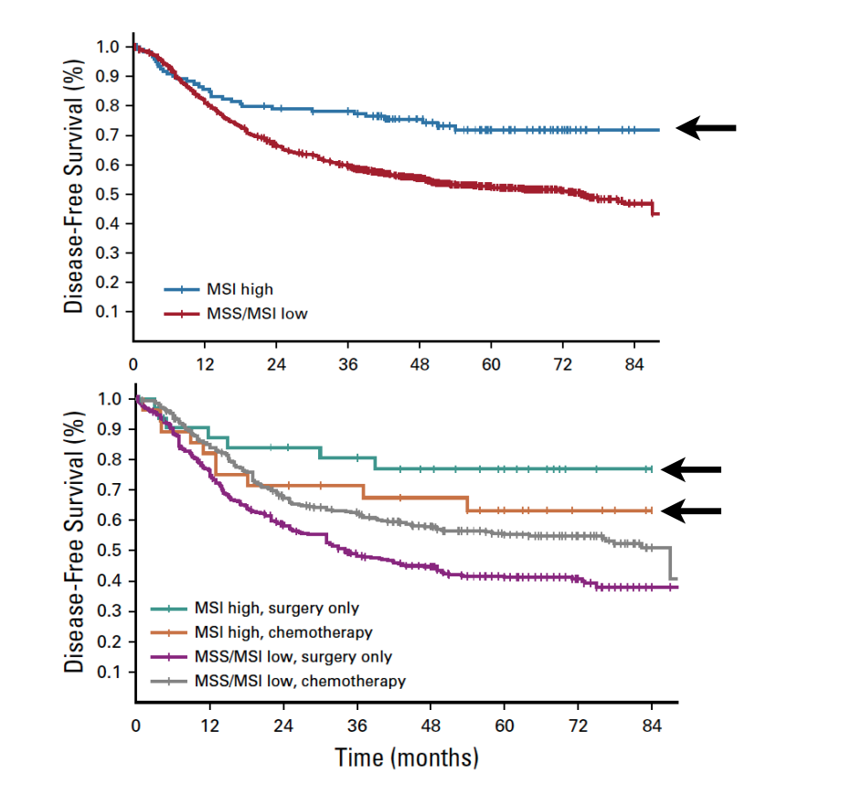
Impact of MSI-H status in response to standard chemotherapy
Prognosis
Response to Chemotherapy
Peri-operative ChT in MSI-high gastric cancer is still debated
MAGIC, CLASSIC, ARTIST, and ITACA-S
Pietrantonio F et al. J Clin Oncol. 2019

Slide 26
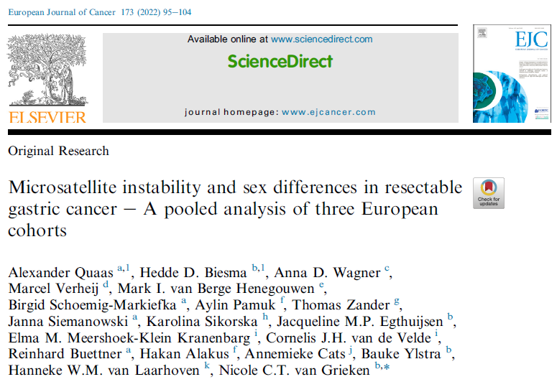
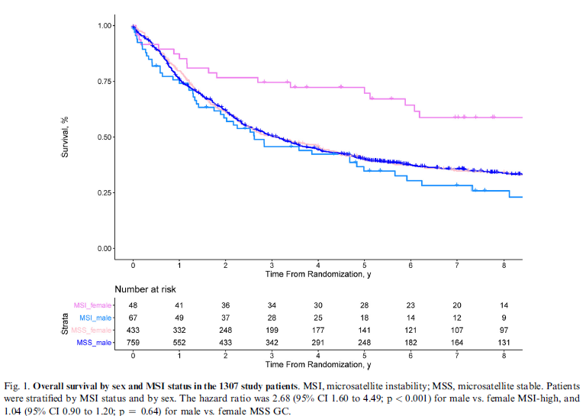


Slide Title
In coclusion:
Favourable prognostic value of MSI was only seen in females.
Sex differences in prognosis and treatment effects in oncology.

Slide 27



The experience of our group
Sex differences in prognosis and treatment effects in oncology
Favourable prognostic value of MSI was only seen in females.
Do Nascimento C et al Cancers 2023

Slide 28

wHO Classification of Tumours of the Digestive System, 5th edition, 2019
Gastric adenocarcinoma of fundic-gland type
Very good prognosis
The tumour consists of irregular architectures, such as tubular fusion and lateral expansion of glands.

Slide 29





Crawling-like adenocarcimoma,
also designated asIntestinal-type adenocarcinoma with anastomosing glands
Genetically distinct group of tumors with RHOA mutations
and CLDN18-ARHGAP fusions, which are thought to be specific to diffuse-type gastric cancers.

Slide 30

Crawling-type adenocarcinoma
Located in the lesser curvature of the middle-third of the stomach; superficial-depressed (0–IIc) or superficial-flat (0–IIb)
Irregularly fused glands with low-grade cellular atypia; lateral spreading in the mucosa; Kato et al. proposed the nickname ‘‘WHYX lesion’’ due to the similarity between these glands and the alphabet letters W, H, Y, and X
Tumor glands may be overlooked, especially in small biopsy specimens; distinction from non-neoplastic lesions, such as intestinal metaplasia, can be challenging
Occasional signet-ring cells; evolution to signet-ring cell carcinoma

Slide 31





Crawling-type adenocarcinoma, rare variant (2%)
early ca
Publications (2006-2023): series of cases & case reports

Slide 32
wHO Classification of Tumours of the Digestive System, 5th edition, 2019
JGCA (2017) | WHO (2019)
Papillary: pap Tubular 1, well-differentiated: tub1 Tubular 2, moderately-differentiated: tub2 | Papillary Tubular, well-differentiated Tubular, moderately-differentiated
Poorly 1 (solid type): por 1 | Tubular, poorly-differentiated (solid)
Signet ring cell carcinoma (SRC): sig Poorly 2 (non-solid type): por2 | Poorly cohesive, SRC type Poorly cohesive, NOS
Mucinous | Mucinous
Description according to the proportion (e.g. por2>sig>tub2) | Mixed
Special type: Adenosquamous carcinoma Squamous cell carcinoma Undifferentiated carcinoma Carcinoma with lymphoid stroma Hepatoid adenocarcinoma Adenocarcinoma with enteroblastic differentiation Adenocarcinoma of fundic gland type | Histological variants: Adenosquamous carcinoma Squamous cell carcinoma Undifferentiated carcinoma Carcinoma with lymphoid stroma Hepatoid carcinoma Adenocarcinoma with enteroblastic Adenocarcinoma of fundic gland type Micropapillary adenocarcinoma
*JGCA, Japanese Gastric Cancer Association {978-4-307-20375-3}. **Table prepared in collaboration with Prof. Ryoji Kushima, Japan
Histological variants:
Adenosquamous carcinoma (separate chapter)
Squamous cell carcinoma (separate chapter)
Undifferentiated carcinoma (separate chapter)
Hepatoid carcinoma
Adenocarcinoma with enteroblastic differentiation
Micropapillary adenocarcinoma
Carcinoma with lymphoid stroma
Adenocarcinoma of fundic gland type
Crawling-type adenocarcinoma?
...
Next editions of JGCA and WHO
classifications?

Slide 33






No bell is ringing!...
Rare flowers
Adenosquamous carcinoma (various amounts of squamous differentiation) admixed with adenocarcinoma component
SMARCA4-deficient undifferentiated gastric carcinoma
(deficient of the SWI/SNF complex complex; decreased expression of BRG1)
Gastroblastoma (biphasic tumor – epithelial and spindle cell componente)
Caused by MALAT1-GLI1 fusion gene

Slide 34


Slide 35



Annals of Oncology, July 2022

Slide 36


. Cancers 2024 Mar 20;16(6):1227

Slide 37
Better understanding for translacion to clinics (Precision Cancer Medicine)
Molecular pathology
(spacial & temporal
heterogeneity)
Genomics,
epigenomics, transcriptomics, proteogenomics
…
Clinical phenotype
Artificial Intelligence
Better understanding
Translation to clinics
(precision cancer medicine)

Slide 38

Thank You!

